Slide 1
My Success Plan
Overview
2022

Slide 2

My Success Plan
Philosophy
My Success Plan enables team members to own their performance, development, and career through meaningful conversations with their people leader
My Performance - Set bold goals and milestones aligned to the HPE strategy and track progress
My Development - Identify development milestones to capitalize on strengths and address growth
My Career - Document a vision for career growth and align development opportunities which drives engagement, performance, and retention.

Slide 3
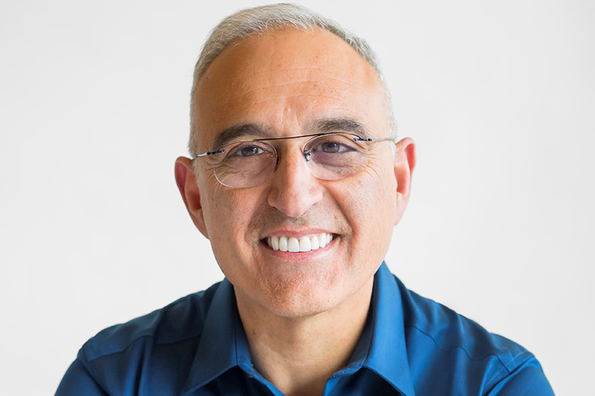
A Champion for Success
“I truly believe you need to bring the next generation forward. Earlier in my career, people saw my potential and spent time with me. I want to do the same.”
Antonio Neri
CEO, Hewlett Packard Enterprise

Slide 4
My Success Plan - The power of 5 conversations
My Success Plan - The power of 5 conversations
Bold Goal Alignment
Nov 1-30
Year-end Performance & Rewards
Oct 1-Dec 16
Career Planning
March 9 – April 15
Development Planning
June -July
Prepare for Year-end
Sept 15-Sept 30
NOV
DEC
JAN
FEB
MAR
APR
MAY
JUNE
JULY
AUG
SEPT
OCT
NOV
DEC
JAN
FEB
MAR
APR
MAY
JUNE
JULY
AUG
SEPT
OCT
All Conversations include Bold Goal progress + Feedback
You may be thinking, “Why do I need to have so many conversations?”
68% of respondents agree that ongoing feedback and development conversations have a positive impact on individual performance (McKinsey Company)

Slide 5
EXPECTATIONs & outcomes PER CONVERSATION
Bold Goal Alignment November 1–30
Year-end Perf & Rewards October 1 – December 16
Career Planning
March 9 – April 15
Development Planning
June – July
Year-end Preparation
September 15 – September 30
Connect with team members to align on bold goals, and action plans to achieve goals in the new fiscal year
Connect with team members on the previous year performance, recognizing performance and future potential with any applicable rewards
Connect with team members on their career aspirations including career goals, feedback, availability for new roles, current skills, and available opportunities.
Connect with team member on their development plan. Address prioritized skills through experience, exposure, and educational opportunities
Prepare for year-end by closing out current bold goals and reviewing any feedback received
EXPECTATION
Team members set bold goals and submit to People Leader
People leaders approve bold goals for team members and submit
Team members and People Leaders complete performance evaluation process
People leaders submit the To-do action for having year-end conversation
Team members acknowledge having the conversation
Team members complete career profile and ensure that their skills are correctly represented.
Team members update bold goals and get and give feedback
Team members acknowledge having the conversation and provide feedback on quality
Team members complete development plan and understand what skills need to be developed
Team members update bold goals and get and give feedback
Team members acknowledge having the conversation and provide feedback on quality
Team members close bold goals, get and give feedback
People leaders request feedback on team members
OUTCOME
Alignment on priorities
Bold goals current in Workday
Clear action plans for what and how to achieve goals
Team members understand their contributions to HPE’s success
Team members understand their performance and development
Team members understand rewards received (if applicable)
Career profiles updated in Workday
Alignment on team member career goals, availability, skills, and next steps
Bold goals updated in Workday
Feedback given and received
Development plans updated in Workday
Alignment on team member development priorities and next steps
Bold goals updated in Workday
Feedback given and received
Bold goals closed in Workday for current fiscal year
Feedback given and received
Team members are prepared to complete their self-evaluation in Workday

Slide 6

Bold goal Alignment
BOLD GOALS
Stretch. Courageous, ambitious.
Aligned. To business priorities and HPE’s broader strategy.
Focused. Specific and measurable.
Sprint-like. Fast-paced with due dates no more than 4-6 months out.
Outcome-oriented. Focused on the impact and outcome.
Team members are 42% more likely to achieve a goal if they write it down and review it regularly.

Slide 7


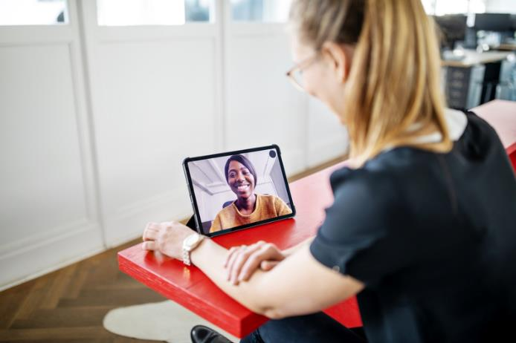
Year-end performance & rewards
Start the conversation
Have a two-way dialogue
Share rewards (if applicable)
Discuss Performance Outcome
Focusing on Performance: the WHAT & the HOW and Learning Agility
Provide feedback
Use the Consolidated Confirmation Statement

Slide 8
Career and development
Everyone plays a role
Ensure development culture, tools, and processes in place
Provide opportunities for depth and breadth of experience
Facilitate development opportunities
HPE ENCOURAGES
Initiate the conversation
Take active role by being supportive and removing barriers
Constantly elevate team members’ talents
34% higher retention rate in organizations that offer professional development
15% higher employee engagement
Leader ENABLES
Prepare for a conversation with the people leader
Identify and document development goals and next steps
Seize opportunities to develop in current and future roles
Team member MANAGES

Slide 9
Career PLANNING
Helping team members consider their options
CAREER CONVERSATION
What do you want to do next at HPE?
Reaching your career goals and experiencing new opportunities starts with highlighting your skills and having a career conversation with your people leader.
CONSIDER YOUR OPTIONS
Vertical. Move Up
Exploratory. Investigate possibilities
Lateral. Move across
Enrichment. Grow in place
Realignment. Stepping back
Transition. Move out
CAREER PROFILE
Your career profile, or internal HPE resume, reflects your current skills and expertise. It helps identify when you’re ready to make an internal career move and informs your people leader about your skills and interests so they can recommend new projects and opportunities in support of your career goals. A completed career profile is key to unlocking specific jobs, projects, learning resources, and opportunities catered to your specific career interests and goals.

Slide 10
Development planning
Experience
Exposure
Education
Special project or stretch assignments
Job rotation program
Best practices: Forums or Knowledge transfer
Networking
Professional Assoc.
Coaching
Open-class schedule
Digital Learning Library
Certification programs
In general, people remember …
10% of what they read, 50% of what they see and hear, and 90% of what they do.
Source: The Learning Pyramid

Slide 11
People leader: Preparing for year-end
Encourage team members to
Close out existing goals
Solicit feedback from peers, stakeholders, customers, and leaders
Reflect on their performance and learning agility
The WHAT and the HOW
Future development needs
Future potential based on career aspirations
Your role in preparing for year-end
Get feedback on your team members from their peers, stakeholders, and customers
PERFORMANCE IMPACT
WHAT: Bold Goal Attainment
Business Impact
Risk Taken
Customer & Stakeholder Feedback
HOW: Demonstrated Behaviors
Demonstration of the HPE Beliefs & Behaviors and HPE Elements of Leadership
LEARNING AGILITY
Desire and ability to learn and apply new concepts in complex situations
Potential to rise in the next 5 years

Slide 12
Team Member: Preparing for year-end
Close out existing goals
Solicit feedback from peers, stakeholders, customers, and leaders
Reflect on your performance and learning agility
The WHAT and the HOW
Future development needs
Future potential based on career aspirations
Use the Performance Evaluation Interactive Guide to prepare for your self-evaluation submission
PERFORMANCE IMPACT
WHAT: Bold Goal Attainment
Business Impact
Risk Taken
Customer & Stakeholder Feedback
HOW: Demonstrated Behaviors
Demonstration of the HPE Beliefs & Behaviors and HPE Elements of Leadership

Slide 13

BOLD Goal progress & Feedback in every conversation
Team members who received regular, meaningful feedback are 3.5x more likely to be engaged than those who receive feedback once a year or less
Only 2 in 10 employees say their performance is managed in a way that motivates them
68% of employees say that regular feedback conversations helped improve their individual work performance (McKinsey)

Slide 14

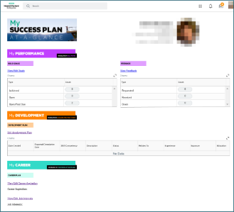
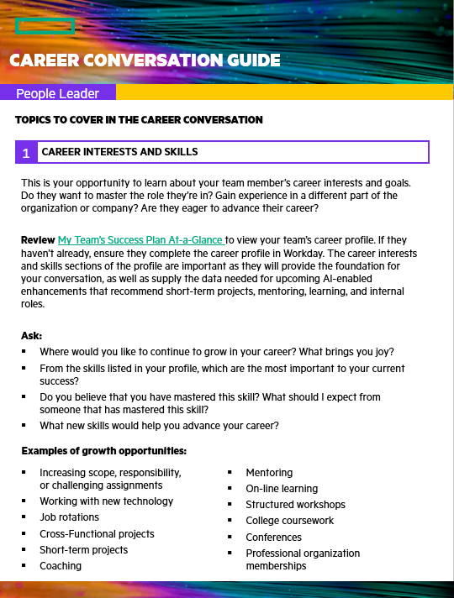
Preparing for the CONVERSATIONS
People leader’s role
Schedule
Review
Consider
Time for the conversation & set expectations with team member
Team member’s My Success Plan
Questions you will ask using the appropriate Conversation Guide

Slide 15

Having successful conversations
What to do…
Be unconditionally inclusive
Keep it informal
Be a coach
Listen actively
Be the cheerleader
What to avoid…
Passing judgment
Telling
Focusing on the short-term

Slide 16
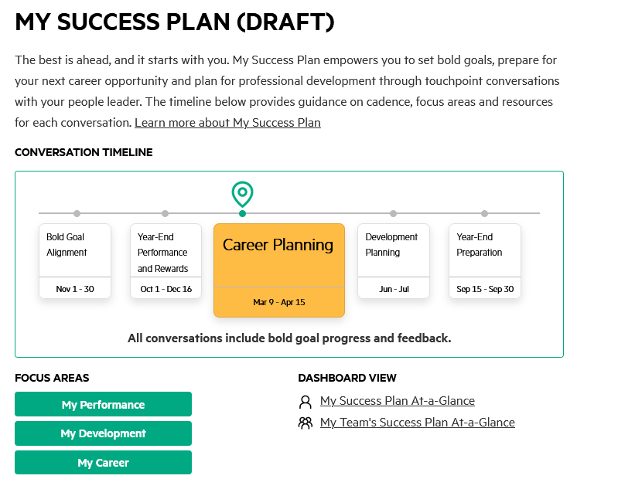
Resources
My Success Plan
https://hr.hpe.com/my-success-plan

Slide 17

Thank You

